Slide 1

Introduction to Git and GitHub

Slide 2


HOW MANY PEOPLE WORKED ON GGPLOT2?

Slide 3
HOW MANY PEOPLE WORKED ON GGPLOT2?
206

Slide 4

HOW MANY PEOPLE WORKED ON TENSORFLOW?

Slide 5
HOW MANY PEOPLE WORKED ON TENSORFLOW?
2,256

Slide 6
AGENDA
1. | Overview Version Control Systems
2. | GitHub Walkthrough
3. | Integrating Git and GitHub with RStudio
4. | Interactive Collaboration Exercise
5. | GitHub etiquette

Slide 7

WHAT IS VERSION CONTROL SYSTEM ?
Track changes to a file
Revert files back to a previous state, revert the entire project back to a previous state,
Review changes made over time
See who last modified something that might be causing problem

Slide 8
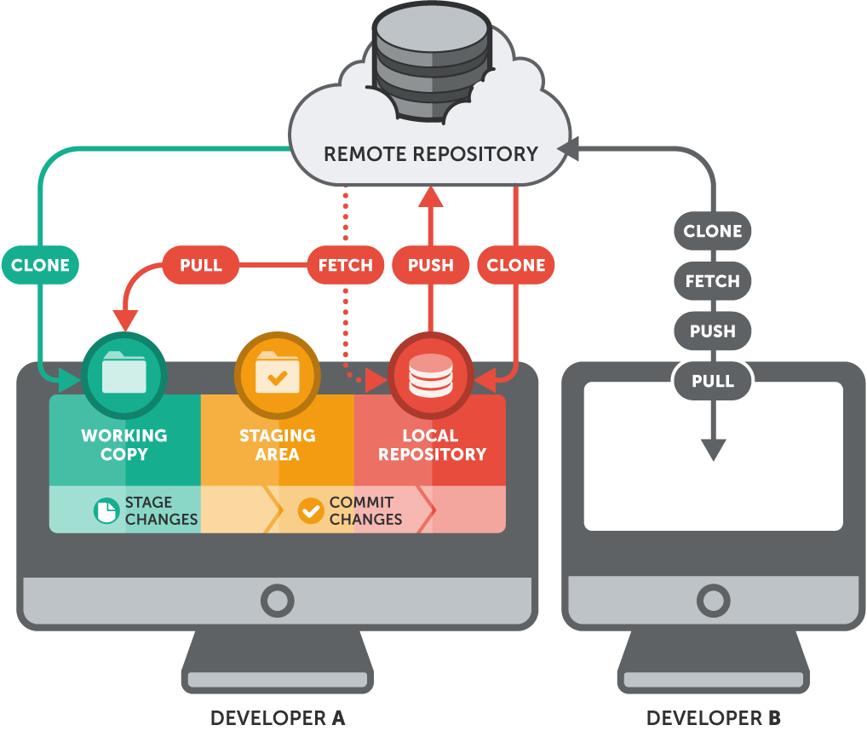
WHAT’S A REPO?
Repository (repo): A directory that contains your project work, as well as a few files which are used to communicate with Git. Repositories can exist either locally on your computer or as a remote copy on another computer.

Slide 9





TYPES OF VERSION CONTROL SYSTEMS?

Slide 10
TYPES OF VERSION CONTROL SYSTEMS?

Slide 11
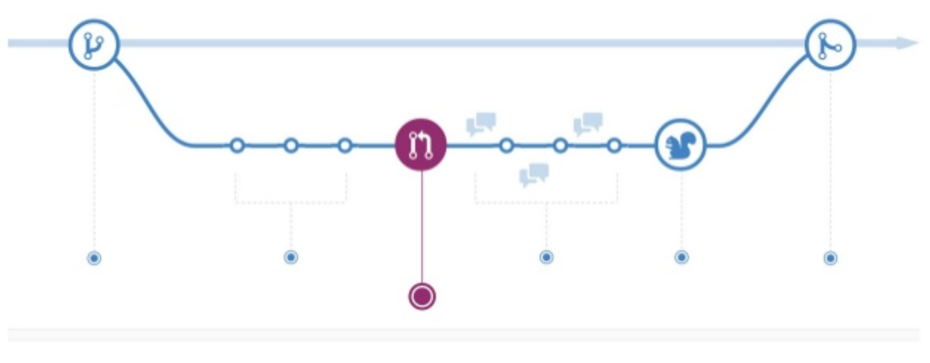
GIT FLOW
MAIN BRANCH
BRANCH
COMITT
PUSH /
MERGE
PULL

Slide 12
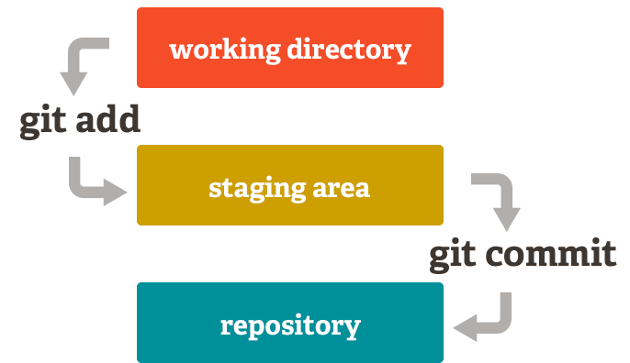
VERSION CONTROL KEY COMMANDS - COMMIT
git commit -m "my changes"
- Records changes to the repo
- Message is a description of the changes

Slide 13
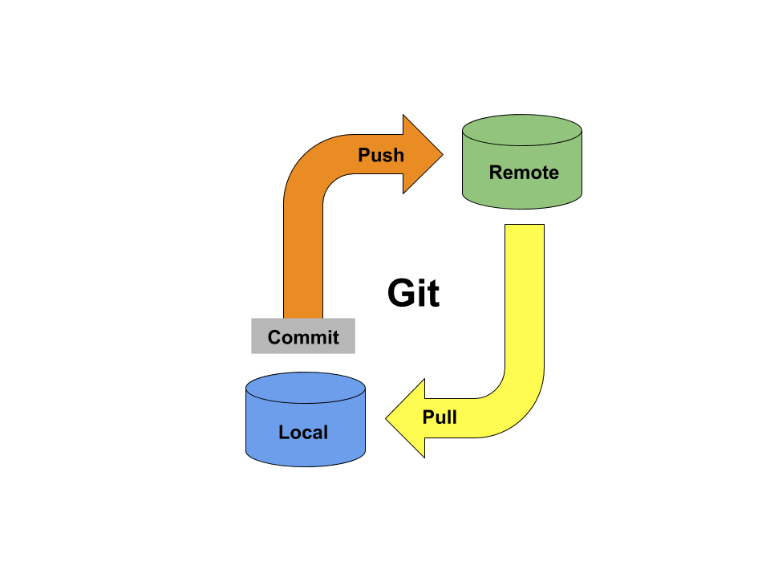
VERSION CONTROL KEY COMMANDS – PUSH
git push
Sends all the changes from your local environment to the remote environment

Slide 14
VERSION CONTROL KEY COMMANDS – PULL
git pull
Request all the changes from the remote environment to your local environment

Slide 15
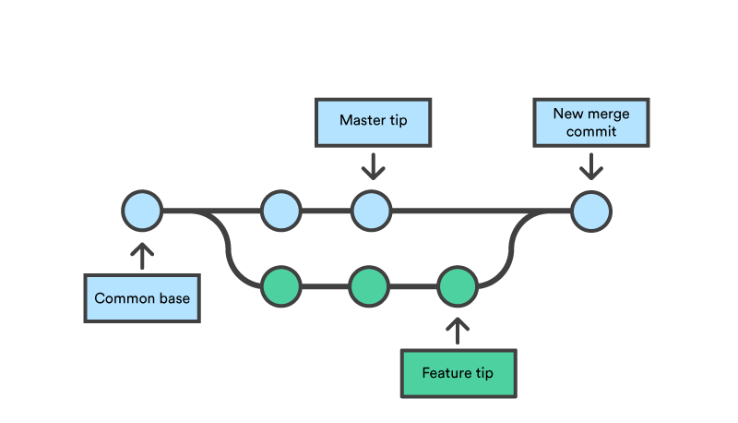
VERSION CONTROL KEY COMMANDS - BRANCH
git branch [branch name]
Working directory that doesn’t impact master branch

Slide 16
AGENDA
1. | Overview Version Control Systems
2. | GitHub Walkthrough
3. | Integrating Git and GitHub with RStudio
4. | Interactive Collaboration Exercise
5. | GitHub etiquette

Slide 17
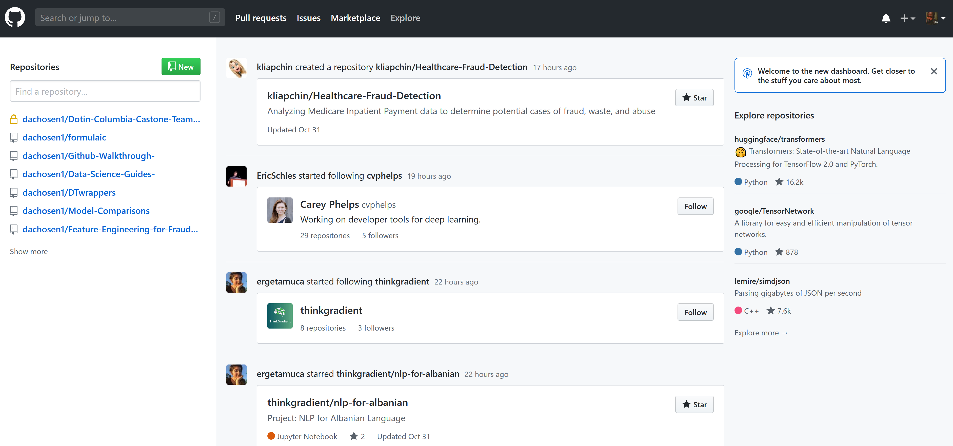
GITHUB HOMEPAGE
Create new repos/ projects
Most recent / most active repos
News Feed

Slide 18
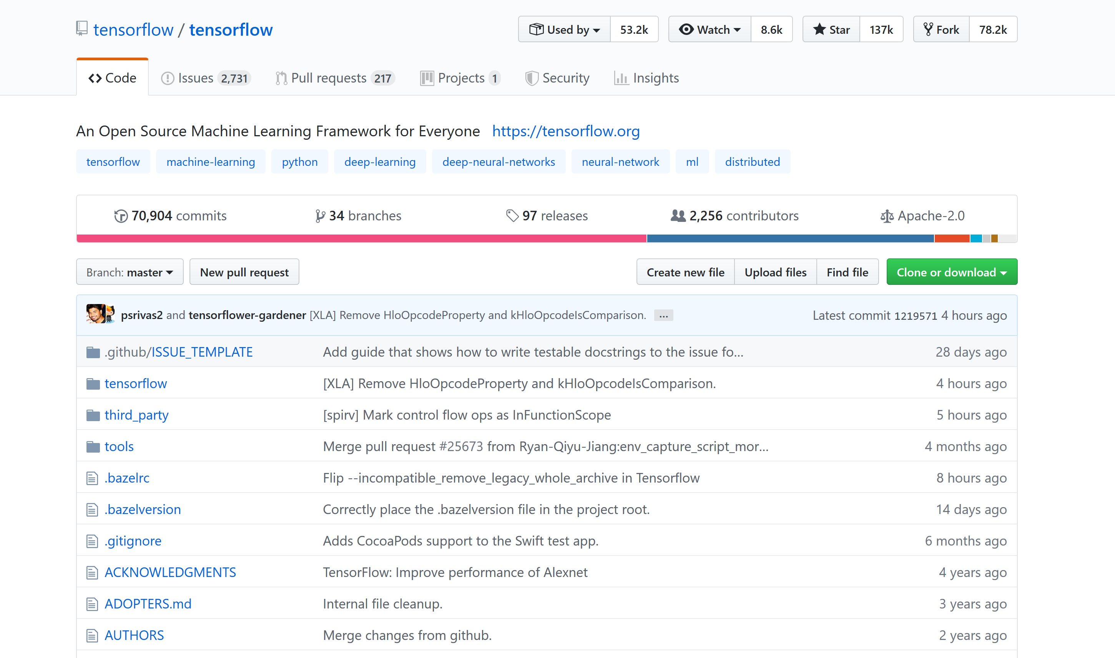
EXAMPLE GITHUB PAGE - TENSORFLOW
Copy the Repo to your page
Request new features
Ask developer questions
Bookmark a repo for later
Download all contents to your desktop
Merge a branch into the master
Be notified of all changes in the rep

Slide 19
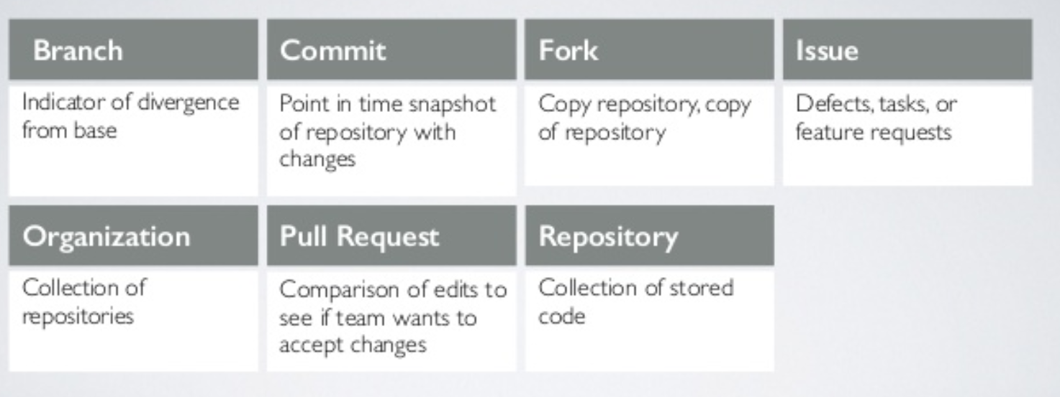
VERSION CONTROL KEY COMMANDS

Slide 20
AGENDA
1. | Overview Version Control Systems
2. | GitHub Walkthrough
3. | Integrating Git and GitHub with RStudio
4. | Interactive Collaboration Exercise
5. | GitHub etiquette

Slide 21
AGENDA
1. | Overview Version Control Systems
2. | GitHub Walkthrough
3. | Integrating Git and GitHub with RStudio
4. | Interactive Collaboration Exercise
5. | GitHub etiquette

Slide 22
COMMAND FOR COLLABORATIVE EXERCISE
git clone https://github.com/dachosen1/Github-Walkthrough-.git
git remote set-url origin https://github.com/dachosen1/Github-Walkthrough-.git
git remote add origin https://github.com/dachosen1/Github-Walkthrough-.git
git INIT
git branch [your branch name]
git checkout [your branch name]

Slide 23
AGENDA
1. | Overview Version Control Systems
2. | GitHub Walkthrough
3. | Integrating Git and GitHub with RStudio
4. | Interactive Collaboration Exercise
5. | GitHub etiquette

Slide 24
GITHUB TIPS BY HADLEY WICKHAMS
1. Profile picture: Spend some time polishing your GitHub home page. Make sure you have a custom image — if you don't want your face on in the internet, pick some image that represents you
2. Pin a few repos that represent particularly strong work. Make sure those repos have concise but descriptive titles, and that you've added a readme that briefly describes the contents. Include a plot/image if you have one
3. If you can't share your usual work, do a couple of tidy Tuesday's or try out other public data analysis challenges

